Slide 1
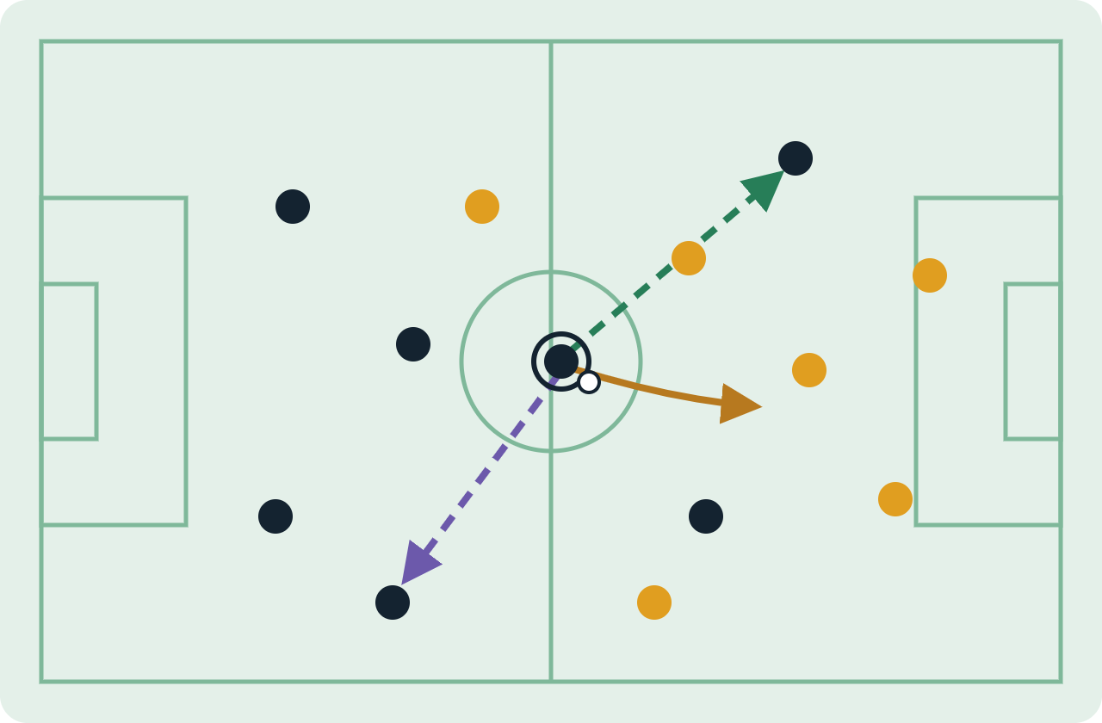
Dynamic Tactical AI
in Football
RESEARCH INTERNSHIP (STAGE) · PROJECT REVIEW
ESILV
DVRC
Internship project overview · October 2026
DE VINCI
ENGINEERING SCHOOL
RESEARCH CENTER
ONE ACTION → MANY POSSIBLE FUTURES
From match tracking data to tactical prediction, simulation and decision support
PRESENTED BY
INTERNSHIP SUPERVISOR
Srinivasan Dhakshanamoorthy
Prof. Ahmed Azough
PROGRAMME
HOST LAB
MSc Data Engineering & AI
De Vinci Research Center
Pass
Carry
Switch
Implemented foundation
Proposed dynamic extension
Notes:
Good morning, my name is Srinivasan Dhakshanamoorthy, MSc Data Engineering and AI at ESILV, working at the De Vinci Research Center under the supervision of Prof. Ahmed Azough. This presentation covers my research internship (stage) project, Dynamic Tactical AI in Football. The idea in one sentence: take raw match tracking data, turn it into tactical states an AI model can learn from, predict how players move next, and — as the proposed extension — simulate alternative futures for tactical decision support. The picture on the right is the intuition: from the same game state, one decision (a pass, a carry or a switch of play) leads to very different futures. In seven slides I will cover the objectives, the system architecture, how it is built, current results and the proposed research direction.

Slide 2
Research question and goals
01 · CONTEXT & OBJECTIVES
ESILV
DVRC
DE VINCI
ENGINEERING SCHOOL
RESEARCH CENTER
RESEARCH QUESTION
O1
O2
How can structured football data help an AI model understand movement, predict what happens next, and explore tactical “what-if” scenarios?
Unify the data
Represent tactics
Real + simulated matches in one format: metres, 105 × 68 m, 10 fps
Key States, 5-second sequences and player graphs
O3
O4
Predict movement
Simulate alternatives
GNN + GRU model for each player’s next move (Δx, Δy)
Counterfactual “what-if” futures for decision support
Why: football is dynamic, tracking data is rich but raw, and analysts want to compare decisions with plausible alternatives.
Implemented (O1–O3)
Proposed extension (O4)
Srinivasan Dhakshanamoorthy · Research Internship · ESILV / DVRC
2
Notes:
Why this project? Football is a continuous, dynamic system; tracking data records positions, speed and direction frame by frame, but raw coordinates are not something a model can reason about tactically — and analysts want to ask "what if the player had done something else?". That leads to the research question: how can structured football data help an AI model understand movement, predict what happens next, and explore what-if scenarios? It translates into four objectives. O1, unify real and simulated data into one common format. O2, represent tactics as Key States, 5-second sequences and player graphs. O3, predict each player's next movement with a GNN plus GRU. These three are implemented. O4, simulating counterfactual futures for decision support, is the proposed extension — shown in purple throughout.

Slide 3

The complete system, end to end
02 · SYSTEM ARCHITECTURE
ESILV
DVRC
DE VINCI
ENGINEERING SCHOOL
RESEARCH CENTER
DATA
PROCESS
REPRESENT
PREDICT
SIMULATE
Real + simulated
Common format
Player graph
GNN + GRU
Dynamic futures
4 Bundesliga matches (DFL / Sportec) and 4 Google Research Football matches
105 × 68 m, 10 fps; Key States kept by a movement threshold; 5 s sequences
Nodes: position, velocity, team, role. Edges: distance, direction, relations
Graph message passing, then a temporal GRU → next movement Δx, Δy
Observed vs alternative A / B → tactical comparison
Implemented
data → common format → Key States → sequences → graphs → GNN / GRU → movement prediction
Proposed
dynamic simulation + counterfactual decision support
Srinivasan Dhakshanamoorthy · Research Internship · ESILV / DVRC
3
Notes:
This is the one slide that shows the whole system. Read it left to right. DATA: real Bundesliga matches from DFL / Sportec plus simulated matches from Google Research Football. PROCESS: everything goes to one common format, and we keep only the Key States where movement is significant, grouped into 5-second sequences. REPRESENT: each state becomes a player graph. PREDICT: a GNN combined with a GRU learns how the graph evolves and outputs the next movement. SIMULATE, in purple, is the proposed extension: generating alternative futures and comparing them tactically. The band at the bottom summarises what is implemented today versus what is proposed.

Slide 4
Data, pipeline and model
03 · TECHNICAL IMPLEMENTATION
ESILV
DVRC
DE VINCI
ENGINEERING SCHOOL
RESEARCH CENTER
01
02
03
04
05
06
Raw tracking
Common format
Key States
Sequences
Graphs
GNN + GRU
position, speed, direction
105 × 68 m, 10 fps
movement threshold
5-second windows
radius or Delaunay
next movement
DATA
MODEL: SPATIO-TEMPORAL GRAPH
REAL
DFL / Sportec — 4 Bundesliga matches (tracking + events)
1
Graph per state — 23 nodes: position, velocity, team, role
SIM
Google Research Football — 4 simulated matches
2
GNN — message passing between connected players
Real matches are the reference; simulation is the controlled environment for comparison.
3
GRU — reads the sequence, predicts Δx, Δy
Stack: Python · Pandas / NumPy · graph tooling · GNN + GRU · Google Research Football
Srinivasan Dhakshanamoorthy · Research Internship · ESILV / DVRC
4
Notes:
This slide shows how the system is built. The top row is the six-step pipeline: raw tracking, conversion to a common format of 105 by 68 metres at 10 frames per second, Key States — only frames where movement reaches a threshold, about 6% of real frames — then 5-second sequences, graphs built with a radius rule or Delaunay triangulation, and finally the GNN plus GRU model. Data: 4 real Bundesliga matches from DFL / Sportec are the reference, and 4 simulated Google Research Football matches are the controlled environment. Model: each state is a graph with 23 nodes; the GNN passes messages between connected players to capture spatial structure, and the GRU reads the sequence over time and predicts each player's next displacement. GNN handles space, GRU handles time.

Slide 5
First end-to-end experiment
04 · RESULTS & VALIDATION
ESILV
DVRC
DE VINCI
ENGINEERING SCHOOL
RESEARCH CENTER
4 + 4
≈ 6%
23
1.13 m
WHAT IT TELLS US
real + sim matches
frames as Key States
nodes per graph
held-out error
1 GNN beats both simple baselines
2 Radius vs Delaunay graphs are close: 1.13 vs 1.17 m
HELD-OUT REAL MATCH — POSITION ERROR
lower is better
3 Simulation transfers less strongly than real patterns
Nobody moves
2.94 m
Keep velocity
1.50 m
NEXT VALIDATION
GNN (ours)
1.13 m
More real matches
Verify simulator time scale
Confirm Key-State definition
More robust graph / model settings
≈62% lower than “nobody moves”, ≈25% lower than “keep velocity”
Srinivasan Dhakshanamoorthy · Research Internship · ESILV / DVRC
5
Notes:
Results of the first end-to-end experiment: 4 real and 4 simulated matches, about 6% of real frames kept as Key States, 23 nodes per graph. On a held-out real match the model never saw, the average position error is 1.13 metres. Two baselines put that in context: "nobody moves" gives 2.94 metres, and "keep velocity" — continuing at constant speed and direction — gives 1.50 metres. Our GNN is roughly 62% and 25% lower respectively, so it learns more than simple physics extrapolation. Radius and Delaunay graphs give similar results, 1.13 versus 1.17 metres. An honest limitation: patterns learned in simulation transfer less strongly to real football. Next validation: more real matches, verifying the simulator's time scale, confirming the Key-State definition, and testing more robust settings.

Slide 6





From prediction to dynamic simulation
05 · USAGE & RESEARCH DIRECTION
ESILV
DVRC
DE VINCI
ENGINEERING SCHOOL
RESEARCH CENTER
PROPOSED RESEARCH LOOP
GAME STATE
ACTION
RESPONSE
NEW STATE
WHAT-IF
tracking + graph
pass / carry / shot
multi-player trajectories
tactical evaluation
alternative future
the new state feeds back as the next game state — repeat with alternative actions
WHERE IT CAN BE USED
Tactical analysis
Movement prediction
What-if analysis
Decision support
states & relationships
response to an action
observed vs alternative
scenarios for coaches
Srinivasan Dhakshanamoorthy · Research Internship · ESILV / DVRC
6
Notes:
Where is this going? Today the model predicts one step of movement. The proposed extension turns it into a closed loop: start from a game state, apply an action such as a pass, carry or shot, predict how multiple players respond, reach a new state that we can evaluate tactically — and then the what-if step: replace the action with an alternative and roll out a different future. The new state feeds back as the next game state, so we can simulate several steps ahead. Applications follow from this: tactical analysis and movement prediction build on what is already implemented; what-if analysis and decision support for coaches are what the extension enables.

Slide 7

Five layers on the simulator
06 · PROPOSED ARCHITECTURE & STATUS
ESILV
DVRC
DE VINCI
ENGINEERING SCHOOL
RESEARCH CENTER
5 Agentic AI
AI coach
22 player agents
Decision support
4 Tactics
Formations
Pass / receiver
Trajectories
What-if
3 Graph
Player graph · 23 nodes
Spatio-temporal GNN · 1.13 m
Tactical state
2 Key States
Key States
Sequences
Types
Phase labels
Space
1 Data
DFL (4 matches)
GRF simulated (4)
Common format
SkillCorner
StatsBomb
SoccerNet
GROUND · Google Research Football
pitch, physics, ball, rules, 22 players, built-in AI
Built
Partly built
Not started
Where we are now: graphs + GNN done · tactical states in progress · next: layer 4 Tactics
Srinivasan Dhakshanamoorthy · Research Internship · ESILV / DVRC
7
Notes:
This slide places the internship in the bigger picture: the proposed architecture is five layers built on top of the simulator, so the project is not only tactical AI. Read it from the bottom up. The ground is Google Research Football: pitch, physics, ball, rules, 22 players and built-in AI. Layer 1, Data: DFL real matches, GRF simulated matches and the common format are built and tested; SkillCorner, StatsBomb and SoccerNet are future sources. Layer 2, Key States: Key States (about 6% of real frames), sequences, the two sequence types (open play and stoppage) and phase labels are built; Space is still open. Layer 3, Graph: every Key State is now a player graph with 23 nodes, and the spatio-temporal GNN is trained, reaching 1.13 m on the held-out real match. Tactical states are in progress: 4 clusters of the GNN embeddings exist, but they mostly separate player speed, so they are not yet tactical. Layers 4 and 5, Tactics and Agentic AI, are not started. Where we are now: graphs and GNN are done, tactical states are in progress, and the next layer is Tactics. Still open: checking the simulator time scale, repeating the comparison on another real match, using the 3 unused DFL matches, and confirming the Key State definition.

Slide 8
Takeaway
07 · CONCLUSION
ESILV
DVRC
DE VINCI
ENGINEERING SCHOOL
RESEARCH CENTER
The foundation is working. The next step is to make the predictions, validate them across more real matches, and test whether alternative futures are tactically meaningful.
ACHIEVED
NEXT
THANK YOU
End-to-end pipeline from tracking data to a GNN + GRU predictor: 1.13 m, better than both baselines
Turn GNN embeddings into tactical states, then build the Tactics and Agentic AI layers
Questions and feedback are very welcome.
Srinivasan Dhakshanamoorthy · Research Internship · ESILV / DVRC
8
Notes:
To conclude: the foundation is working. We have an end-to-end pipeline from raw tracking data to a spatio-temporal graph model that predicts movement with 1.13 metres error on an unseen real match, better than both baselines. The next step is to make predictions dynamic — multi-step simulation and counterfactual what-if futures — validate on more real matches, and check that the alternative futures are tactically meaningful. Thank you for your attention; I would be glad to take your questions and feedback.

